Slide 1
Enhance Bluetooth Security by Improving RSA Algorithm
Submitted By Supervised By
MD. Akibul Alam (0804060) Thomas Chowdhury
Assistant Professor, Dept. of CSE, CUET

Slide 2
Motivation
Monitoring the old system of RSA algorithm for Bluetooth.
Find out old system bugs & probability.
Provide a secure way to connect and exchange data between devices through Bluetooth.
Propose an improvement of RSA algorithm for Bluetooth security.

Slide 3
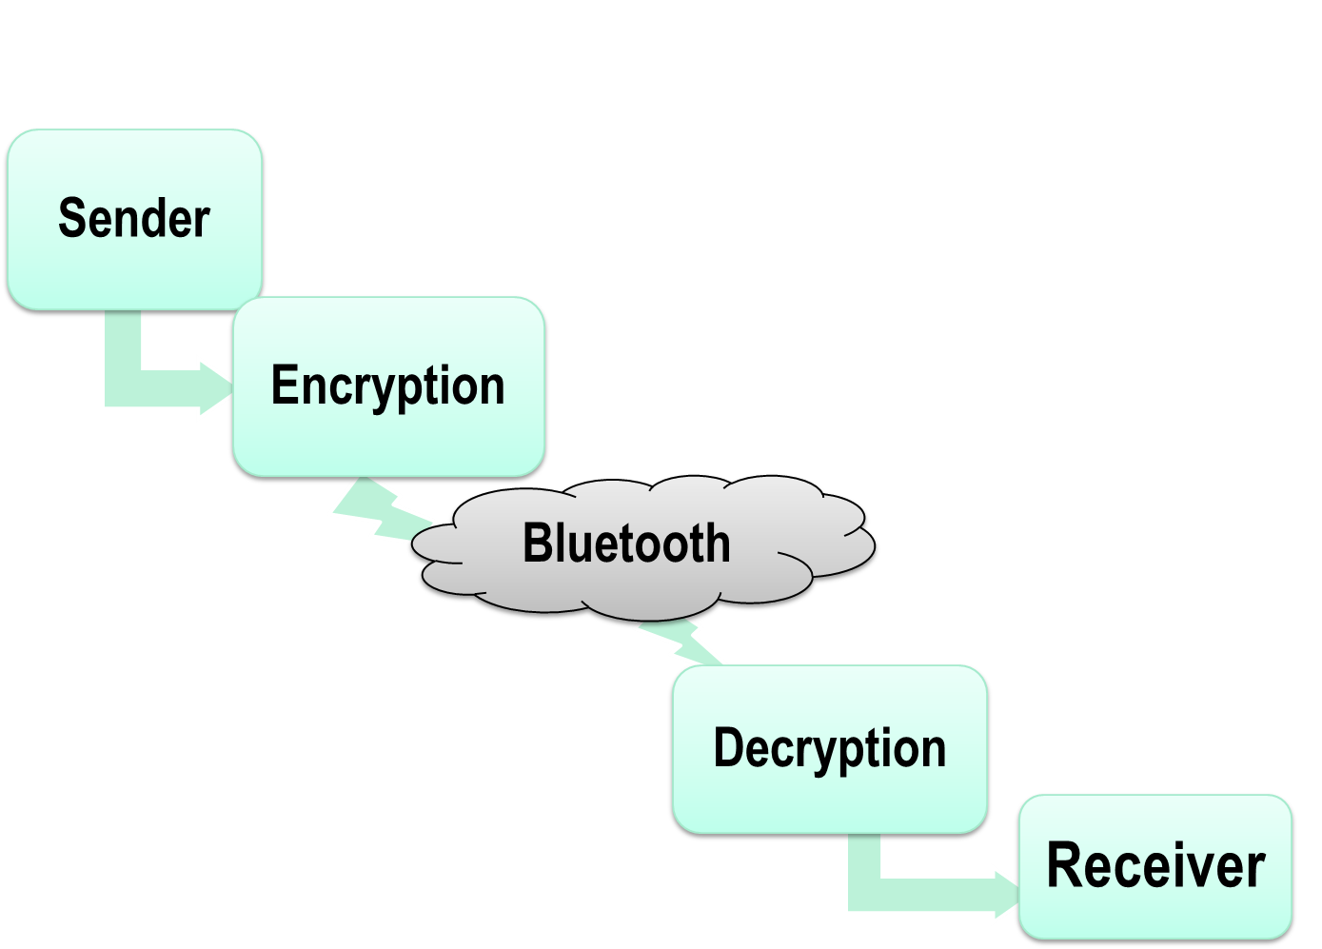
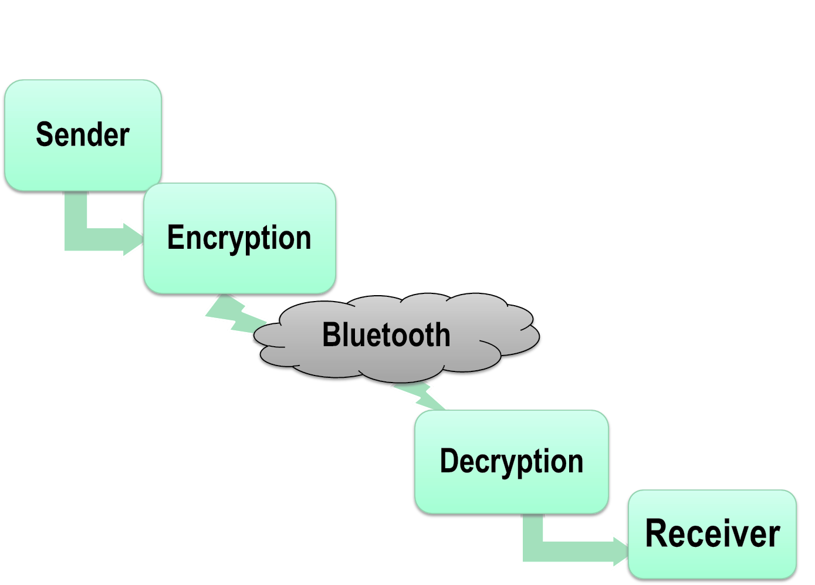


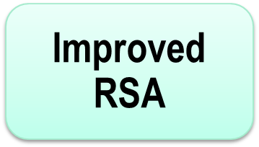
Methodology
Figure 1: Bluetooth data transfer

Slide 4
Limitations of Bluetooth Security
Battery Exhaustion
Signal Jamming
Man-in-the-Middle Attack
Surveillance Attacks
DoS Attacks
Malware Attacks
Obfuscation Attacks
Sniffing Attacks
UDDA Attacks
Fuzzer Attacks
Hciconfig
Spooftoph
BlueSpooof
Bthidproxy
Blue printing
Blue Scanner
Bluebag
Caribe & CommWarrior
Bluetooth
1. Bloover
2. Bluebag & Bluefish
BlueSniff
Kismet
Blue pass
Blue smack

Slide 5
Limitations of RSA algorithm
Integer factorization problem
Faulty key generation
Adaptive chosen cipher text attacks
Side-channel analysis attacks

Slide 6
RSA Improvements
Original Message
Receiver key K-PRIV
Cipher text 1
Sender key K-PRIV
Cipher text 2
RSA
Cipher text 3
Figure 2: Encryption Improvements

Slide 7
RSA Improvements(Cont…)
Cipher text 3
RSA
Cipher text 2
Sender key K-PRIV
Cipher text 1
Receiver key K-PRIV
Original Message
Figure 3: Decryption Improvements

Slide 8
References
[1] Trishna Panse, Vivek Kapoor, Prashant Panse, “A Review on Key Agreement Protocols used in Bluetooth Standard and Security Vulnerabilities in Bluetooth Transmission” International Journal of Information and Communication Technology, Research, Volume 2, Number 3, 2012
[2] Li Juan, Chen Bin, Li Kun, “Study on the Improvement of Encryption Algorithm of Bluetooth” 21-23 Oct. 2011, in conference of Computational and Information Sciences (ICCIS), 2011 International Conference, pp. 971 - 974
[3] Wuling Ren, Zhiqian Miao, “A Hybrid Encryption Algorithm Based on DES and RSA in Bluetooth Communication”, International Journal of Computer Science and Security (IJCSS), Vol.2,: Issue No .2,Year 2011.
[4] Jun-Zhao Sun, Douglas Howie, Antti Koivisto and Jaakko Sauvola, Media Team, Machine Vision and Media Processing unit, InfoTech Oulu, University of Oulu, Finland “Design Implementation and Evaluation of Bluetooth Security”, http://www.mediateam.oulu.fi/publication/pdf/83.pdf

Slide 9

Thanks to all

